Slide 1
3rd Iteration Presentation
Sarah Price Ruth Whitehouse May Kamreen Lillian Sheppard
Notes:
Good evening, we're IT Girls and this is the final presentation for our Heart Health Status Prediction.

Slide 2

Agenda
Overview
Results
Roles
Sprint Performance
Website Preview
Visualization Update
Documentation
Notes:
To give a quick schedule for the presentation this evening:
First, we'll go through an overview of the project and our goals, followed by the results of our analysis on the dataset. Next, we'll cover the roles each team member played in the final result, what we were able to accomplish, and what we would like to accomplish in the future. We'll give you a quick preview of the website we created, an update on our visualizations, and a look at the final documentation.

Slide 3
Project overview
Sarah Price
Notes:
I'm Sarah Price, and I will quickly review the team and goals of the project.

Slide 4
The Team
Sarah Price Team Manager Lead Data Analyst
Ruth Whitehouse Client Liaison Lead Data Modeler
Shababa Kamreen Visualizer Scrum Master
Lillian Sheppard Co-Visualizer Project Scribe
Notes:
Our team is made up of 4 members – Sarah Price: team manager and data analyst
Ruth Whitehouse: client liaison and data modeler
May Kamreen: Visualizer and Scrum master
and Lily Sheppard: co-visualizer and project scribe.

Slide 5
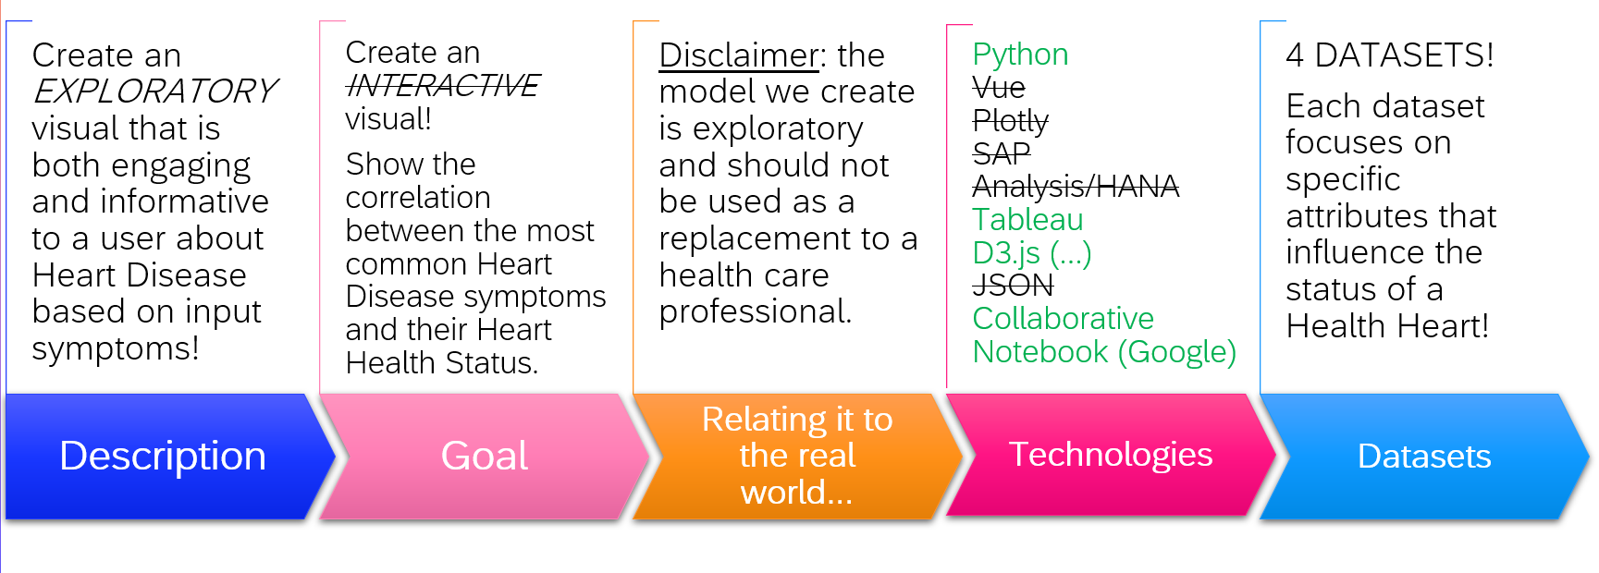
Project Re-cap
Notes:
When we began this project, we had a vague idea of our end goal and what tools we wanted to research. Overall, we knew that we wanted to explore the factors that contributed to heart disease, and create an interactive visualization to show the correlations between risk factors and diagnosis. Due to time constraints, we were unable to implement the interactive portion of the project, though we hope that either we or another team will have a chance to develop that capability in the future. In our initial presentation, we listed several technologies we were considering using. We ended up only using a few of the initially listed technologies, including Python, Tableau, d3.js, and Google Colab. We each pulled a dataset to analyze, and ended up using 3 of these 4 in one merged set to analyze risk factors.

Slide 6
Implemented Features
Statistical
Visual
Complete Regressional Analysis for each of our top contributing risk factors (Age, Cholesterol, Diabetes, Hypertension, Physical Inactivity, and Smoking)
Successful application of PCA to all datasets to narrow down which of the factors have the most impact on heart diease.
Thorough Statistical Analysis and K-Means Clustering for a more in-depth analysis.
Create accurate and engaging visuals for all statistical tests performed on the data!
Notes:
We have completed a regression analysis on several factors, and in seeing these results, determined that PCA (Principal Component Analysis) would be a more accurate way to run metrics. After completing the PCA, we were able to see that the factors that contribute most to the likelihood of a patient getting heart disease were age and sex.
We also ran additional statistical analysis and K-means clustering for a more in depth look at those factors. This information can be found in our Google Colab notebook.
We are now able to implement visualizations of the results of the analyses we ran on the merged datasets.

Slide 7

Future Features
Notes:
Unfortunately, like I mentioned in a previous slide, we were unable to implement an interactive function for our predictive model – this is something we hope another team picks up in the future.

Slide 8

Project Timeline
25 Jan.
Week 1 (1/25)-(1/31)
Team formation
Assign Project Roles
Create Project Charter
1 Feb
Week 2 (2/1)
Gather datasets
GitHub Repo
Formulate Hypothesis
8 Feb
Weeks 3 & 4 (2/8)-(2/21)
1st Iteration: Present Team Plan, Technologies, Collections, and GitHub Repo
22 Feb
Week 5 (2/22)-(2/28)
Performance, Scalability, and Efficiency
Work on Project Visualizations
1 Mar
Week 6 (3/1)-(3/7)
Look for Simple Patterns that Align to Project Goals
8 Mar
Week 7 & 8 (3/8)-(3/28)
2nd Iteration: Clean data collections, Insights/Patterns, Hypothesis, Tableau/Visualize
29 Mar
Weeks 9 & 10 (3/29)-(4/11)
Build a Predictive Model
12 Apr
Week 10 (4/12)-(4/25)
Final Project Demo
CREATE Symposium
Final Project Report

Slide 9
Project Flowchart
Life Cycle
1. Formulate Hypothesis
II. Collect Datasets
III. Clean Data
IV. Create Model
V. Test Model
VI. Deploy Model
We are here -->

Slide 10
results
Sarah Price
Notes:
Based on our exploration of individual datasets, we determined several different hypotheses:
1. The higher a person's cholesterol, the more likely a person is to have heart disease.
2. Older patients have a higher likelihood of being heart disease positive
3. There is a direct correlation between patients who have diabetes and those who have heart disease
As lead data analyzer, I was able to run several different statistical analyses on our combined dataset, beginning with regression, then using PCA to determine the factors with the most impact, and several other statistics based on those risk factors.

Slide 11
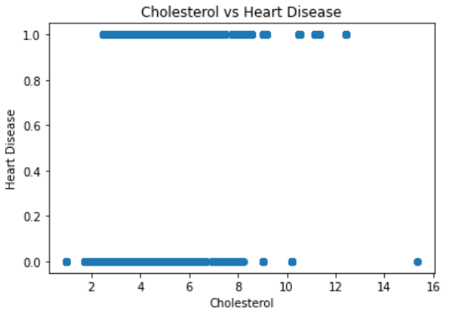
Cholesterol vs Heart Disease
We hypothesized that higher cholesterol put the patients at higher risk for heart disease.
The linear regression analysis between cholesterol and heart disease shows an R² value of 0.1526.
This is not a very strong correlation.

Slide 12
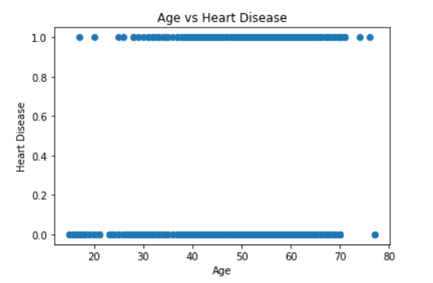
Age vs Heart Disease
The next hypothesis we wanted to test was whether age impacted heart disease positivity.
While the binary diagnosis still makes the graph hard to read, we can clearly see that the age for heart disease positive patients is typically higher than patients without.

Slide 13
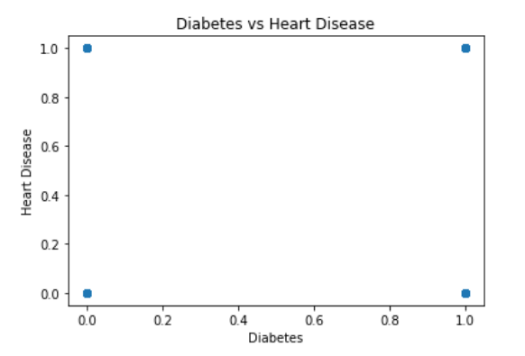
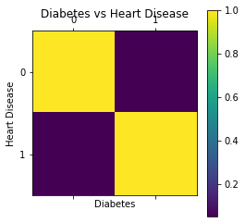
Diabetes vs Heart Disease
Based on our individual data exploration, we theorize that patients who have diabetes have a higher risk of heart disease.
This correlation is also extremely low - the R² value is only a 0.0499.
Because both factors in this correlation are binary, a scatterplot is not the best way to show the correlation between the two factors. In order to get a better look at the information, we'll try a correlation matrix.

Slide 14
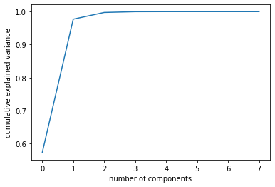
Applying PCA
Because we had so many risk factors included in our dataset, we wanted to narrow down which of those would have the most impact on the likelihood that a patient would have heart disease.
In doing this, we determined that the first 2 factors in the dataset were the most important – age and sex.

Slide 15
roles
Sarah Price
Notes:
During this final sprint, each of our team members played a crucial role in the completion of our project.

Slide 16
Team Effort! (Week 10)
Sarah
Ruth
May
Lily
Complete the process of applying PCA to our datasets.
Solve the dataset merging prolem.
Complete Linear Regression models for hypotheses.
Contribute to Website
Create Website sections and contribute some information.
Work on Visualization (Tableau and d3.js)
Contribute to Website.
Work on Visualization (Tabluea and d3.js)
Create Project Poster
Create template for Final Report.
Contribute to Final Report.
Prepare Final Presentation.
Update Github Repo
Contribute to Final Report.
Contribute to Final Report.
Notes:
As lead data analyst, I was able to apply PCA to our dataset to determine the most important factors, as well as running regression analysis on several of the other factors that were included in our dataset.
Ruth, as data modeler, was key in solving an issue with our datasets being merged – one of the datasets was focusing on an individual person instead of a population of patients. She also did a good amount of work on organizing the information in our website so that it was easy to understand and visually pleasing.
May has worked with Tableau and d3.js to develop visualizations that tell the story of our data in a quick glance and found the template we are using for our website.
Lily assisted May in the creation of the visualization, in addition to developing the poster for our CREATE presentation and the templates for all of our presentations and reports. She has done a fantastic job of keeping our GitHub repo updated and organized throughout our creation process.
The entire team has contributed to the information and layout on the website and the information included in our final report.

Slide 17
Sprint performance
Sarah Price
Notes:
To quickly recap what we've accomplished in each spint:

Slide 18
Iteration Sprints
PAST
PRESENT
FUTURE
Notes:
So far, we've been able to accomplish all that we need to for the past 2 iterations! This includes finding and cleaning datasets, running initial analysis on each to determine hypotheses, combining them into one dataset, and analyzing the combined data.
Currently, we are working on the visualization portion of our iteration.
Unfortunately, due to time constrains, we will not be able to complete one
implementation that we had planned to incorporate which was an
INTERACTIVE model. This is a feature that can be worked on in the future.

Slide 19
Website preview
Ruth Whitehouse

Slide 20
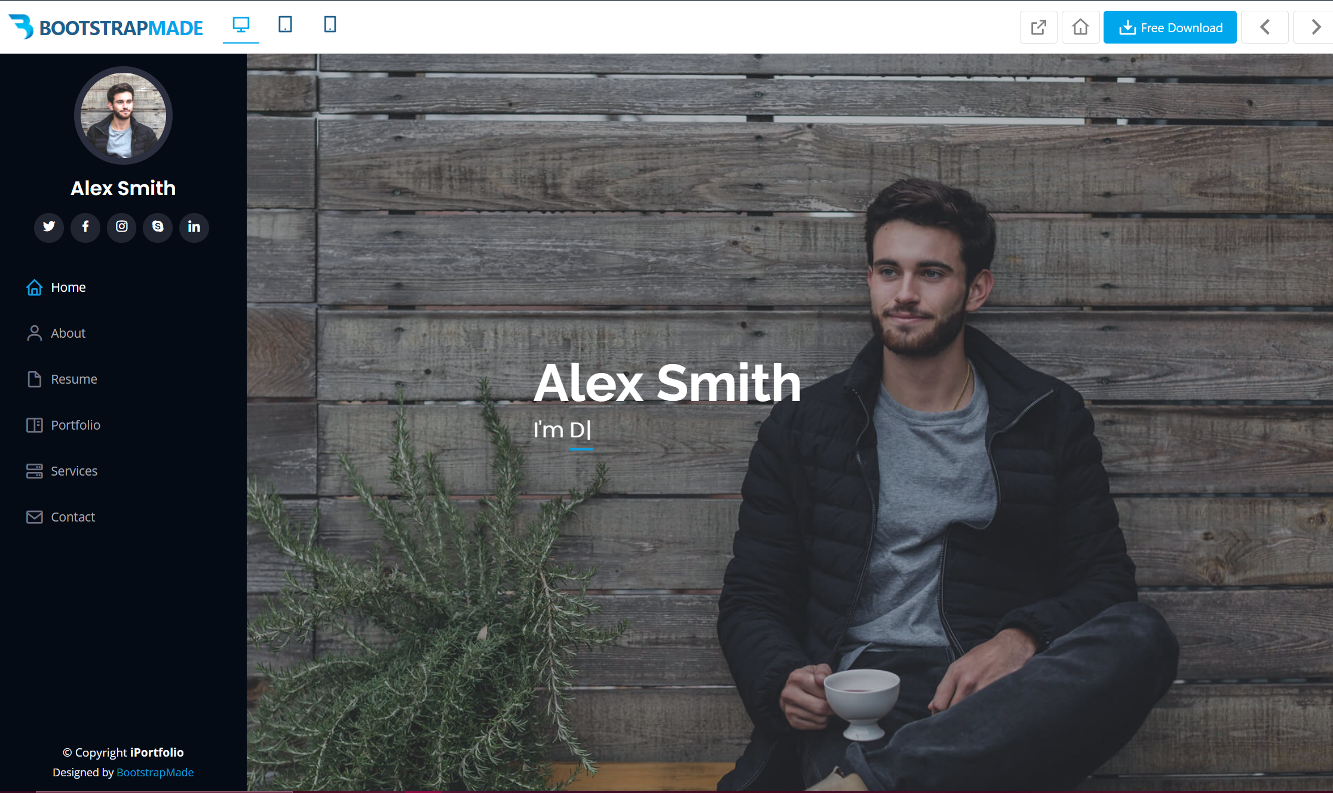
Notes:
This is the template we’ll be using.

Slide 21
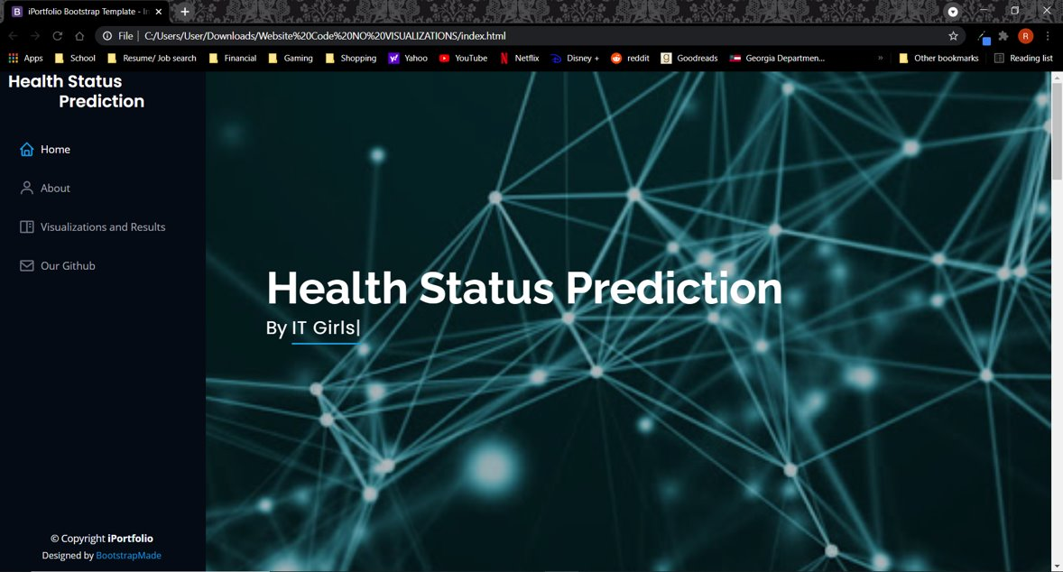
Notes:
What we've got so far...

Slide 22
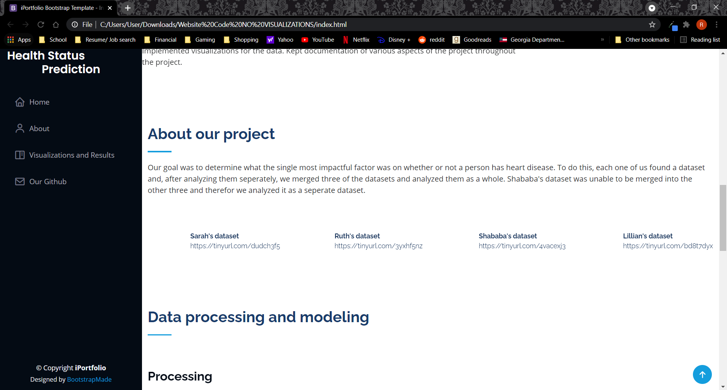
Notes:
What we've got so far...

Slide 23
Visualization Update
May Kamreen

Slide 24
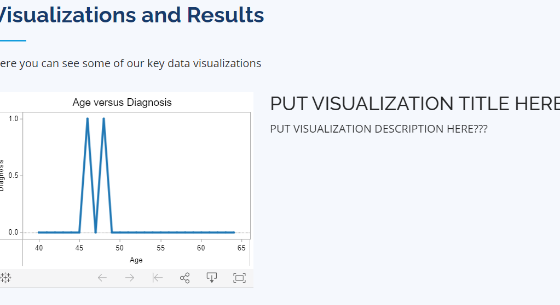
Notes:
This is our visual in Tableau!

Slide 25
D3.js Visual coming soon...
Notes:
We are still working on our d3.js visual!

Slide 26
documentation
Lillian Sheppard

Slide 27
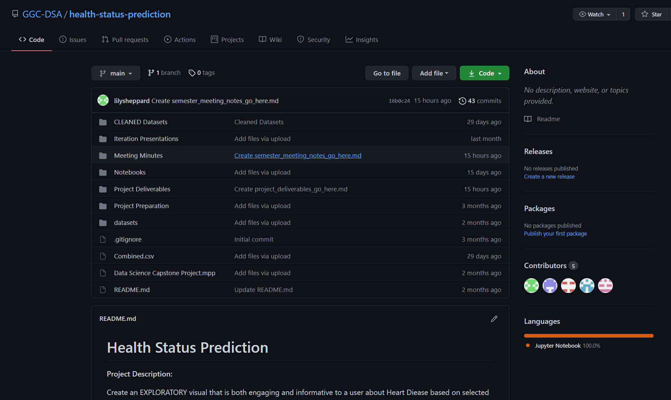
Notes:
These are our Github Repo Updates!
We’ve made some really good progress, but I’ve added some more folders.
The two new folders are:
1. Meeting Minutes (so that others can follow our creative process)
2. Project Deliverables (where the final products will be stored)
Information is being added to our ReadMe which will navigate people through our folders (I.e. which documents are where – like a table of contents).
The very last thing i need to add is a folder called "Code" where we will upload our codes for the website and the visualizations once we've completed those tasks.

Slide 28




Thank you

